Slide 1

DRDO ACADEMIC DEMONSTRATOR
AI-Powered Organizational PC Health
& Predictive Maintenance Ecosystem
Telemetry-driven anomaly detection, failure-risk forecasting, and semantic repair intelligence — unifying fleet health monitoring with an evidence-based technician recommendation engine.
Predictive AI/ML Telemetry Suite // Semantic NLP Repair Search // FastAPI + React

Slide 2




PROJECT OVERVIEW
From Complaint to Evidence-Based Resolution
An enterprise platform to manage and maintain PC assets across departments — integrating predictive telemetry models with a semantic NLP search index over completed repairs. When a technician raises a complaint, the AI diagnoses the signal, retrieves the most similar historical fixes, and synthesizes a recommended action.
The Continuous Feedback Loop
Sensor telemetry streams into SQLite time-series storage
1
2
Complaint triggers the AI diagnostic pipeline (/api/analyze)
Detect
Diagnose
3
Semantic search retrieves the 3 closest resolved cases
Continuous telemetry anomaly & risk scoring across the fleet
Fuses sensor + complaint-text signals into one assessment
4
Technician confirms the repair and commits the outcome
New repair is instantly re-indexed for future retrieval
5
Recommend
Retrieves top 3 similar past repairs, synthesizes a fix plan
02

Slide 3




SYSTEM ARCHITECTURE
How Data Moves Through the Ecosystem
Fleet Data
AI Diagnostic Pipeline
Semantic Retrieval
Recommendation
Sensor telemetry stream
SQLite time-series store
Complaint text input
>
Feature engineering
Classifiers + fusion layer
Anomaly · health · RUL
>
Query embedding
Cosine-weighted search
Top-3 similar repairs
>
Synthesized fix plan
Technician resolution form
Commit → DB & re-index
Closed loop: confirmed repairs are committed to the database and CSV, then trigger an incremental update of the embedding index — resolving the originating ticket.
03

Slide 4






AI / ML MODULE ARCHITECTURE
Ten Models Working in Concert
Feature Engineering
Multiclass Problem Classifier
Complaint NLP Classifier
15+ indicators: TemperatureStress, VoltageDeviation, CoolingEfficiency
Tree-based model over raw telemetry: overheating, memory leak, disk, power
TF-IDF + Logistic Regression on historical complaint text logs
Multimodal Fusion
Isolation Forest
Health · Risk · RUL
Reconciles sensor vs. NLP predictions into one final assessment
Flags hardware anomalies against normal operating baselines
Regressors & classifiers trained on engineered degradation targets
Trend Forecasting
Explainability
K-Means Fleet Clustering
Linear regression over historical telemetry time-series logs
Top-5 feature attributions scaled by deviation from healthy baseline
4 segments: Stable, High-Utilization, Elevated-Thermal, Voltage-Instability
04

Slide 5

SEMANTIC REPAIR INTELLIGENCE
Finding the Closest Precedent, Instantly
Repair history is embedded with SBERT (falling back to a local TF-IDF model offline). Every new complaint is scored against the archive using a weighted cosine-similarity formula across four fields, surfacing the three most relevant completed repairs for the technician.
Retrieval → Recommendation Flow
FINAL SIMILARITY WEIGHTING
Encode
New complaint + symptoms converted to a query embedding
Complaint Text
55%
Search
Cosine-weighted match against the repair embedding index
Symptoms
20%
Problem Type
15%
Rank
Top 3 most similar completed repairs surfaced
Model Context
10%
Synthesize
Recommendation engine drafts an evidence-based plan
Re-index
Confirmed fix is embedded and added to the archive
05

Slide 6



ENGINEERING & TECH STACK
Built on a Modern, Testable Foundation
Backend
Frontend
ML / Data
FastAPI application entrypoint
SQLAlchemy + SQLite persistence
Modular services: prediction, embedding, similarity, recommendation
13+ unit & integration Pytests
React + Vite single-page app
Tailwind CSS component styling
Dashboard, Raise Complaint, Repair Resolution, Fleet, History pages
Central fetch API service layer
scikit-learn classifiers & regressors
SBERT / TF-IDF embedding pipeline
Serialized model binaries (.pkl)
CSV-seeded SQLite training data
06

Slide 7
FLEET & DATA SNAPSHOT
The Numbers Behind the Demo
100
400
4
10
PCs in the organizational fleet
Historical repair records indexed
Operational fleet clusters (K-Means)
AI / ML models in the pipeline
FLEET SEGMENTATION (K-MEANS)
Stable
High-Utilization
Elevated-Thermal
Voltage-Instability
Healthy baseline operation
Elevated CPU / RAM load
Temperature trending high
Irregular voltage readings
07

Slide 8


SCOPE & DISCLOSURE
Academic Demonstration, Real-World Pattern
Synthetic Data Disclaimer
All PC records, incident locations, departments, employee identities, telemetry metrics, and repair logs are synthetic and created purely for academic demonstration and simulation. They do not represent real-world incidents, infrastructure, operational failures, or assets of DRDO or any other organization.
Project Structure at a Glance
backend/app — FastAPI, services, ML modules
frontend/src — React pages & components
Why It Matters
models/ — serialized regressors, classifiers, embeddings
Demonstrates a full closed-loop MLOps pattern: telemetry to inference to retrieval to feedback
Combines structured sensor ML with unstructured NLP retrieval in one recommendation engine
Provides a reusable template for any organization managing distributed hardware fleets
organization_pcs.csv & repair_history.csv — source data
train.py & seed_database.py — pipeline entrypoints
08

Slide 9
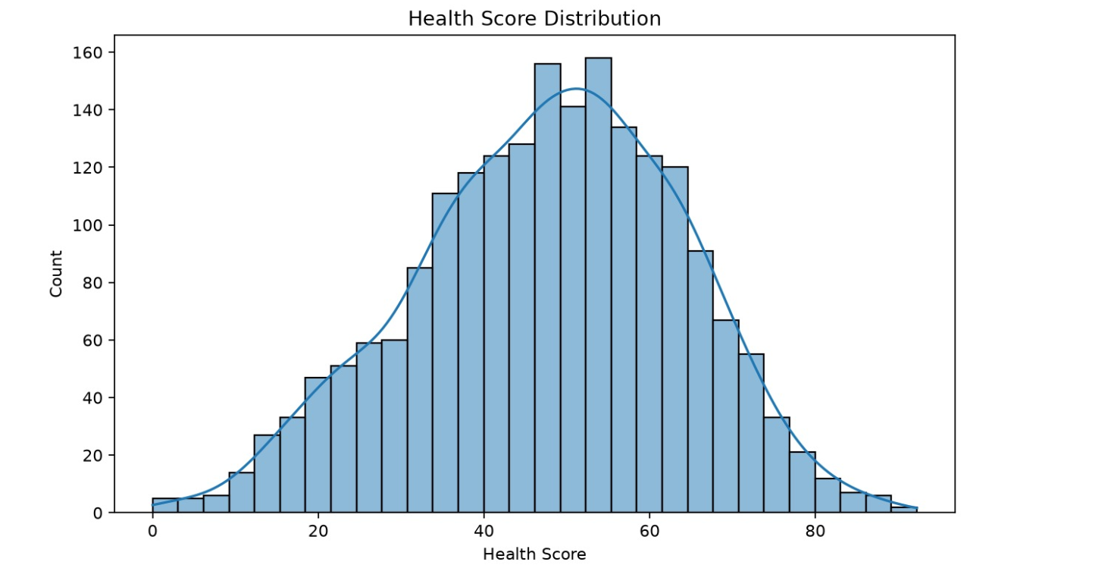
Health Score Distribution
This histogram presents the distribution of machine health scores across the monitored equipment. The x-axis represents the health score, while the y-axis indicates the number of machines falling within each score range.
Key Observations:
The distribution follows an approximately bell-shaped (normal) pattern, centered around a health score of 50–55.
Most machines have health scores between 40 and 65, indicating a generally stable operating condition.
Very low health scores (below 20) and very high health scores (above 80) occur less frequently.
The smooth density curve highlights the overall trend and confirms that the majority of assets maintain moderate health levels.
The balanced distribution suggests that the dataset contains a mix of healthy, moderately healthy, and potentially at-risk machines.

Slide 10
Health Score Distribution
This histogram presents the distribution of machine health scores across the monitored equipment. The x-axis represents the health score, while the y-axis indicates the number of machines falling within each score range.
Key Observations:
The distribution follows an approximately bell-shaped (normal) pattern, centered around a health score of 50–55.
Most machines have health scores between 40 and 65, indicating a generally stable operating condition.
Very low health scores (below 20) and very high health scores (above 80) occur less frequently.
The smooth density curve highlights the overall trend and confirms that the majority of assets maintain moderate health levels.
The balanced distribution suggests that the dataset contains a mix of healthy, moderately healthy, and potentially at-risk machines.

Slide 11
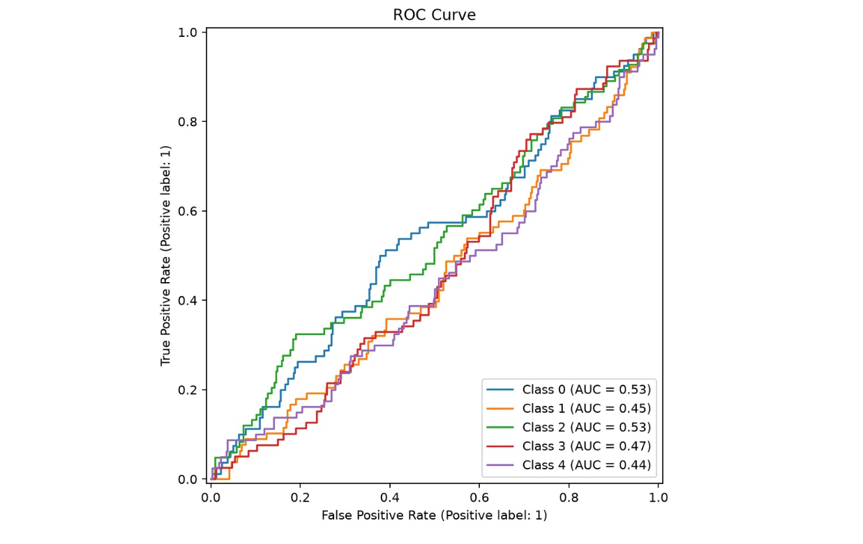
ROC Curve Analysis:
The Receiver Operating Characteristic (ROC) Curve evaluates the classification performance of the predictive maintenance model across multiple classes. It illustrates the relationship between the True Positive Rate (Sensitivity) and the False Positive Rate at various classification thresholds.
Key Observations:
The graph presents ROC curves for five different classes (Class 0–4).
The Area Under the Curve (AUC) values range from 0.44 to 0.53.
Class 0 and Class 2 achieve the highest AUC values (0.53), indicating slightly better discrimination performance than the other classes.
The ROC curves remain close to the diagonal line, suggesting that the model's ability to distinguish between classes is currently limited.
Classes 1, 3, and 4 have AUC values below 0.50, indicating performance close to random classification

Slide 12
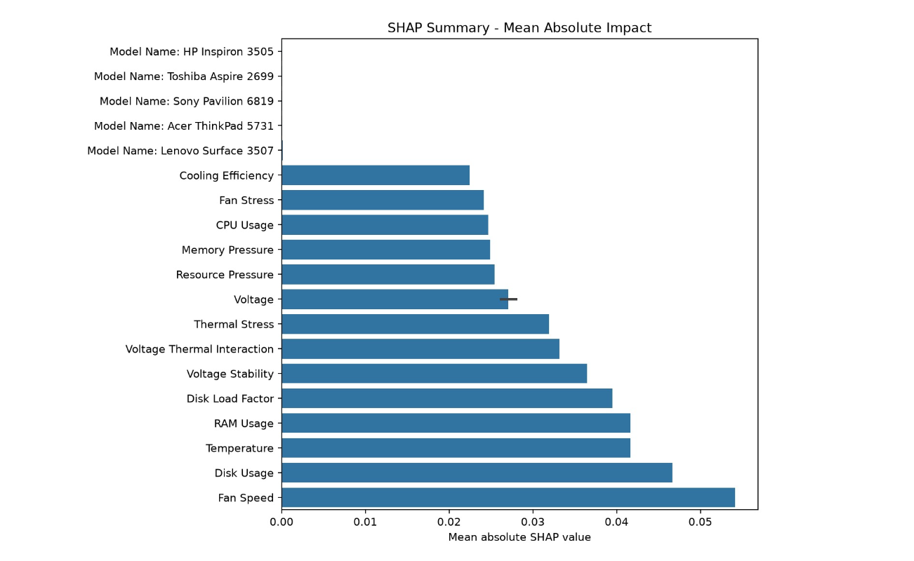
SHAP Summary Analysis – Mean Absolute Impact:
This SHAP (SHapley Additive exPlanations) summary chart illustrates the relative importance of features used by the predictive maintenance model. The x-axis represents the mean absolute SHAP value, which indicates the average contribution of each feature to the model's predictions.
Key Observations:
Fan Speed has the highest SHAP value, making it the most influential factor affecting the model’s predictions.
Disk Usage and Temperature are the next most significant features, highlighting the importance of system workload and thermal conditions.
RAM Usage and Disk Load Factor also contribute substantially, indicating that memory and storage performance impact system health predictions.
Features such as Voltage Stability, Voltage-Thermal Interaction, and Thermal Stress show moderate influence on the model's decision-making process.
CPU Usage, Memory Pressure, Fan Stress, and Cooling Efficiency have comparatively lower impacts but still contribute to prediction outcomes.

